Slide 1
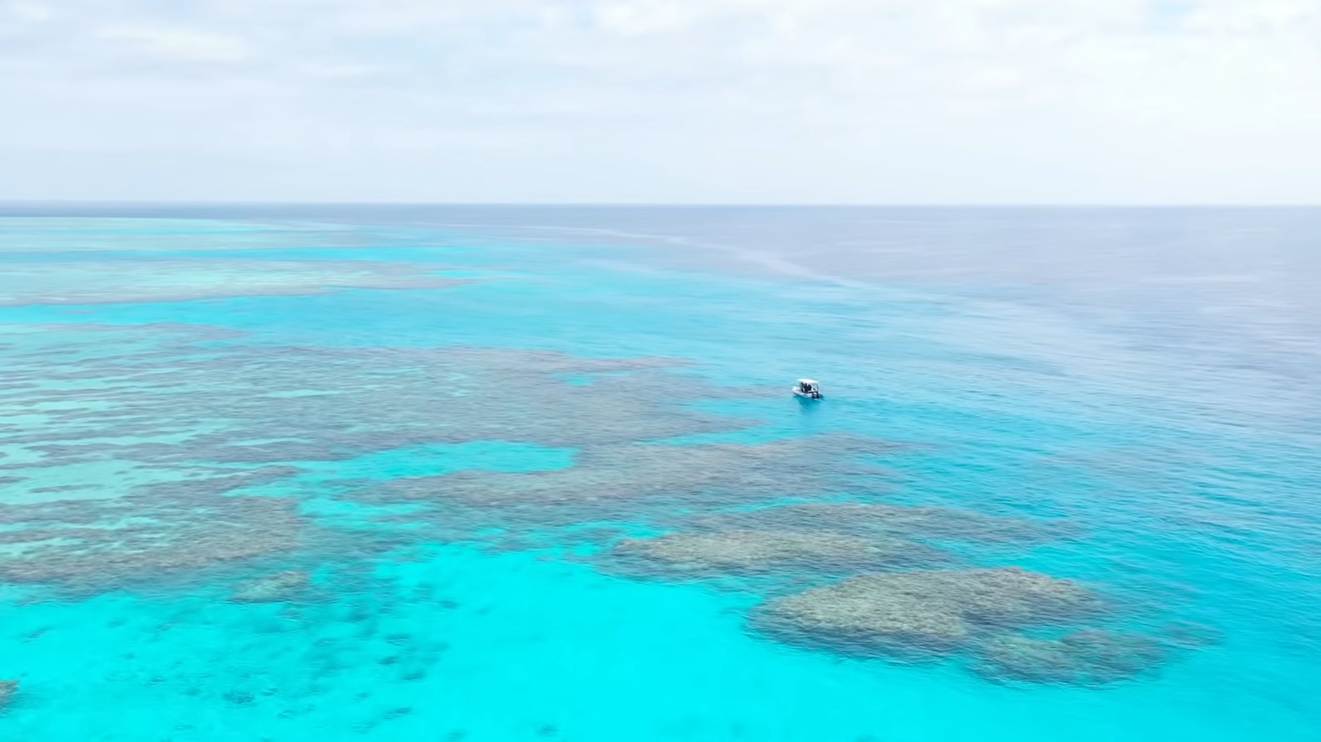
Great Barrier Reef Invasive Starfish Detector
Team 8
Nick Wagner | David Unger

Slide 2
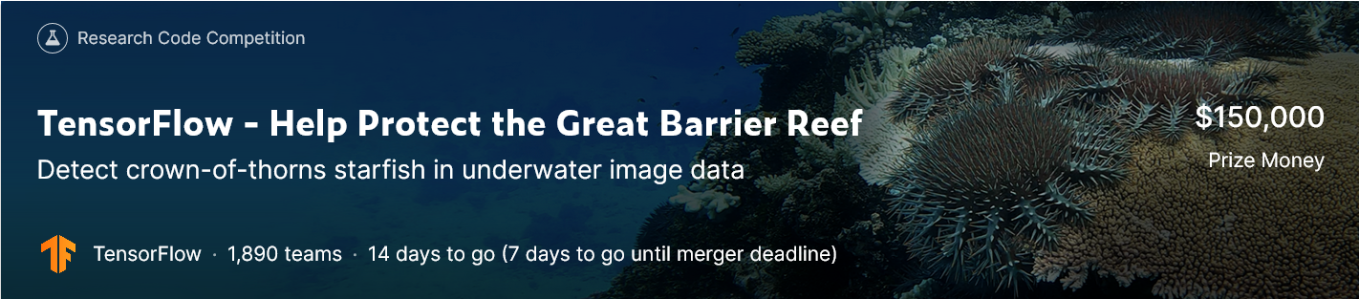
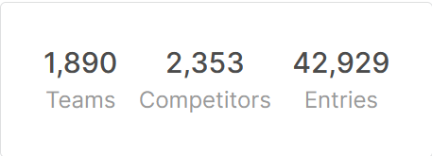
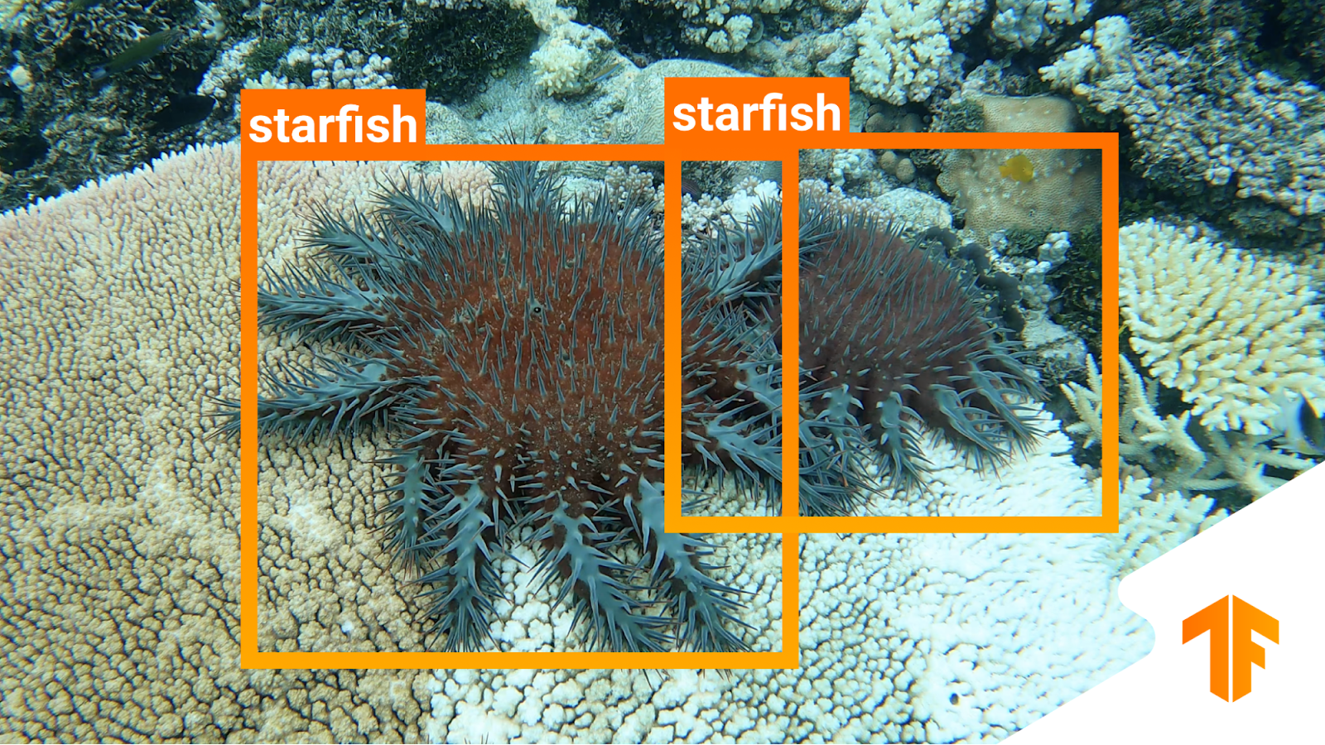
1 Problem Statement
Our goal: Implement a YOLO object detector from scratch
Dataset:
~23000 images from 3 video sequences
bounding box labels from csv
Challenge: Objects barely distinguishable from background
https://www.kaggle.com/c/tensorflow-great-barrier-reef/overview/description
https://www.google.com/url?sa=i&url=https%3A%2F%2Fblog.tensorflow.org%2F2021%2F11%2Fannouncing-tensorflows-kaggle-challenge.html&psig=AOvVaw3pZWcfWwVYD7HMyphUNG62&ust=1643789767389000&source=images&cd=vfe&ved=0CAsQjRxqFwoTCNCrpJ6I3vUCFQAAAAAdAAAAABAJ

Slide 3
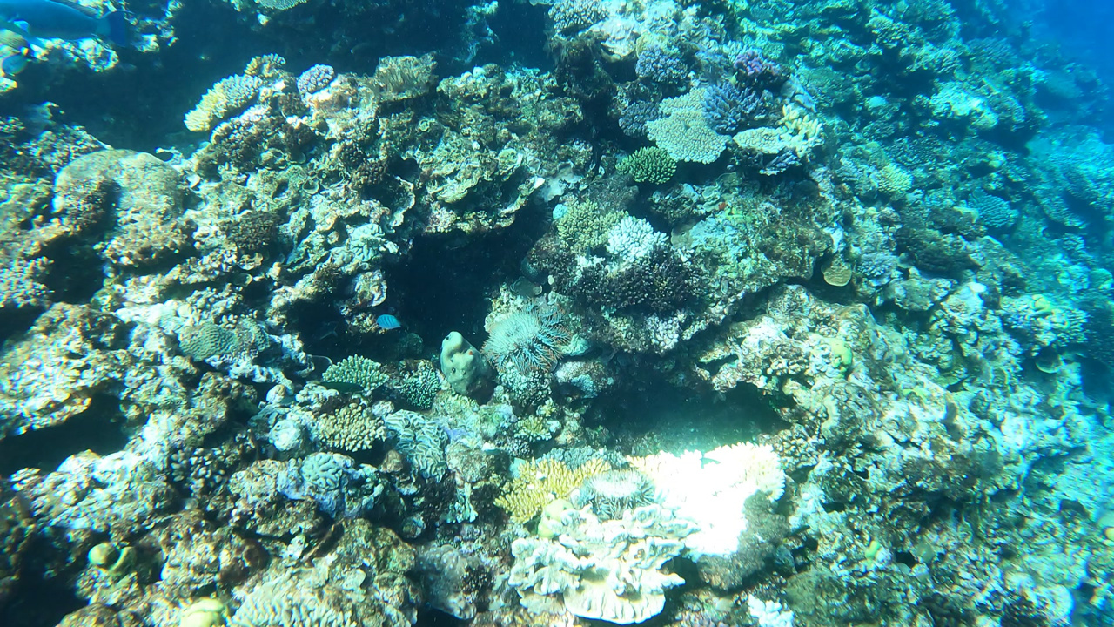
1 Problem Statement

Slide 4
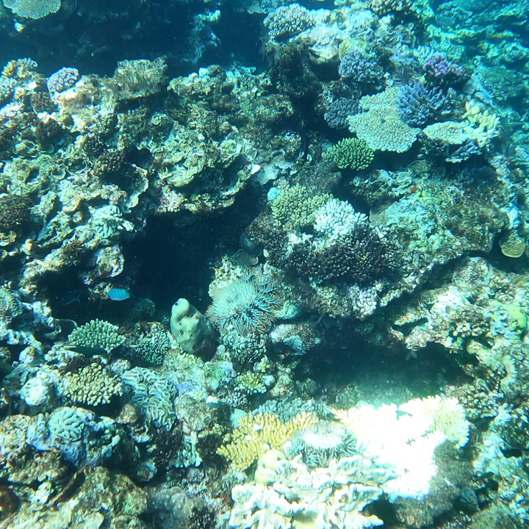
2 Our YOLO Architecture
448x448x3
14x14x2048
7x7x1024
7x7x1024
7x7x5
plot
3x3x1024 + stride = 2
conv. layer
3x3x5 + padding
conv. layer
details
input image
resnet50
dropout
TBC: show global or relative values
objectness
x-center
y-center
width
height
0 0 0 0 0 0 0
0 0 0 0 0 0 0
0 0 0 0 0 0 0
0 0 0 0 0 0 0
0 0 0 0 0 0 0
0 0 0 0 0 0 0
0 0 0 0 0 0 0
0 0 0 0 0 0 0
0 0 0 0 0 0 0
0 0 0 0 0 0 0
0 0 0 0 0 0 0
0 0 0 0 0 0 0
0 0 0 0 0 0 0
0 0 0 0 0 0 0
0 0 0 0 0 0 0
1
0 0 0 -0.5 0 0 0
0 0 0 115 0 0 0
0 0 0 0 0 0
0 0 0 336 0 0 0
0 0 0 105 0 0 0
0 0 0 0 0 0 0
0 0 0 0 0 0 0
0 0 0 0 0 0 0
0 0 0 0 0 0 0
0 0 0 0 0 0 0
0 0 0 0 0 0
0 0 0 0 659 0 0
0 0 0 0 534 0 0
0 0 0 0 98 0 0
0 0 0 0 67 0 0
1
0 0 0 0 0 0 0
0 0 0 0 0 0 0
0 0 0 0 0 0 0
0 0 0 0 0 0 0
0 0 0 0 0 0 0
Notes:
[{'x': 540, 'y': 336, 'width': 115, 'height': 105}, {'x': 659, 'y': 534, 'width': 98, 'height': 67}]“
WHY RELATIVE TO BOUNDING BOX?

Slide 5
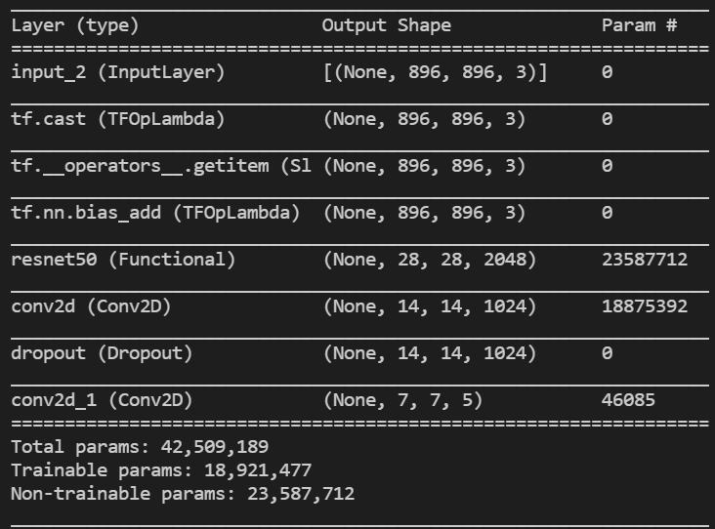
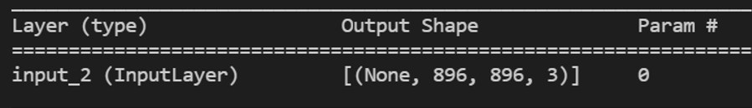
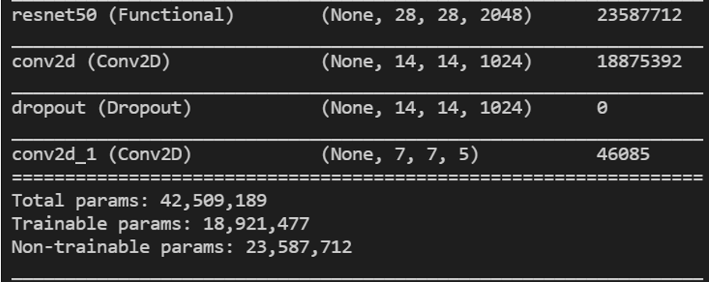
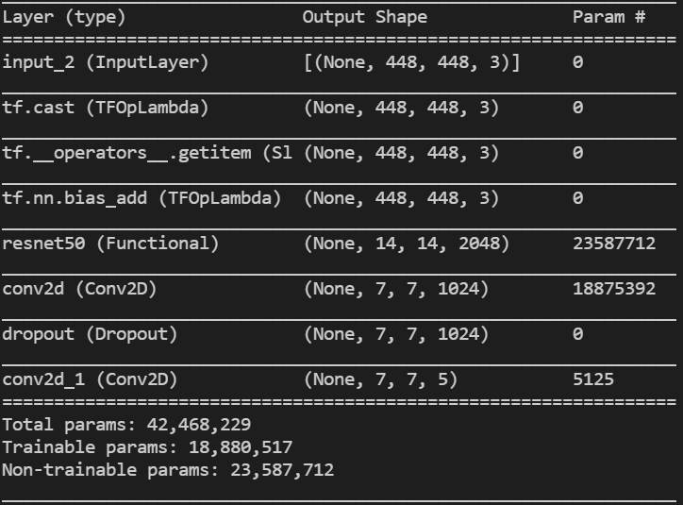
objectness
x-center
y-center
width
height
0 0 0 0 0 0 0
0 0 0 0 0 0 0
0 0 0 0 0 0 0
0 0 0 0 0 0 0
0 0 0 0 0 0 0
0 0 0 0 0 0 0
0 0 0 0 0 0 0
0 0 0 0 0 0 0
0 0 0 0 0 0 0
0 0 0 0 0 0 0
0 0 0 0 0 0 0
0 0 0 0 0 0 0
0 0 0 0 0 0 0
0 0 0 0 0 0 0
0 0 0 0 0 0 0
1
0 0 0 540 0 0 0
0 0 0 115 0 0 0
0 0 0 0 0 0
0 0 0 336 0 0 0
0 0 0 105 0 0 0
0 0 0 0 0 0 0
0 0 0 0 0 0 0
0 0 0 0 0 0 0
0 0 0 0 0 0 0
0 0 0 0 0 0 0
0 0 0 0 0 0
0 0 0 0 659 0 0
0 0 0 0 534 0 0
0 0 0 0 98 0 0
0 0 0 0 67 0 0
1
0 0 0 0 0 0 0
0 0 0 0 0 0 0
0 0 0 0 0 0 0
0 0 0 0 0 0 0
0 0 0 0 0 0 0
objectness
x-center
y-center
width
height
0 0 0 0 0 0 0
0 0 0 0 0 0 0
0 0 0 0 0 0 0
0 0 0 0 0 0 0
0 0 0 0 0 0 0
0 0 0 0 0 0 0
0 0 0 0 0 0 0
0 0 0 0 0 0 0
0 0 0 0 0 0 0
0 0 0 0 0 0 0
0 0 0 0 0 0 0
0 0 0 0 0 0 0
0 0 0 0 0 0 0
0 0 0 0 0 0 0
0 0 0 0 0 0 0
1
0 0 0 0 0 0 0
0 0 0 0 0 0 0
0 0 0 0 0 0 0
0 0 0 0 0 0
0 0 0 0 0 0 0
0 0 0 0 0 0 0
0 0 0 0 0 0 0
0 0 0 0 0 0 0
0 0 0 0 0 0 0
0 0 0 0 0 0 0
0 0 0 0 0 0
0 0 0 0 0 0 0
0 0 0 0 0 0 0
0 0 0 0 0 0 0
0 0 0 0 0 0 0
1
0 0 0 0 0 0 0
0 0 0 0 0 0 0
0 0 0 0 0 0 0
0 0 0 0 0 0 0
0 0 0 0 0 0 0

Slide 6
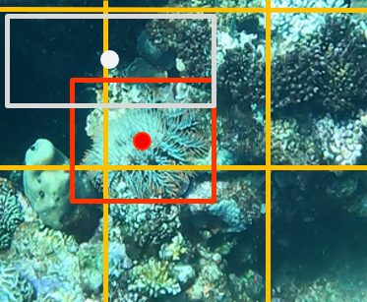
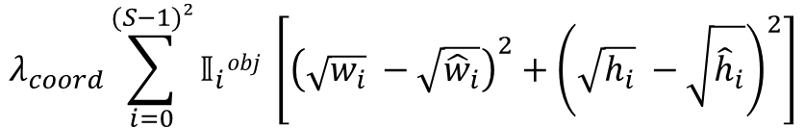
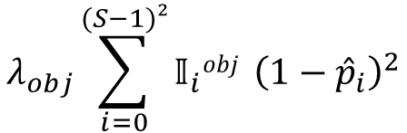
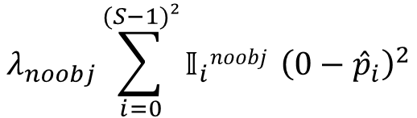
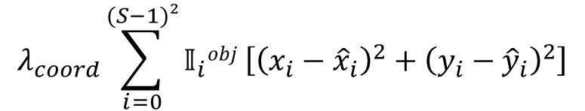
3 Loss Function
Bounding box center loss
Δx
Bounding box size loss
Object loss
No object loss
0 0 0 0 0 0 0
0 0 0 0 0 0 0
Δw
0 0 0 0 0 0 0
0 0 0 0 0 0 0
0 0 0 0 0 0 0
0 0 0 0 0 0 0
Δy
1
0 0 0 0 0 0
1
0 0 0 0 0 0
0 0 0 0 0 0 0
0 0 0 0 0 0 0
0 0 0 0 0 0
0 0 0 0 0 0
1
1
Δh
0 0 0 0 0 0 0
0 0 0 0 0 0 0
$$λ_{obj}\sum_{i=0}^{(S−1)²}{𝕀_{i}obj }{\left(1−{\hat{p}}_{i}\right)}^{2}$$
$$λ_{coord}\sum_{i=0}^{(S−1)²}{𝕀_{i}obj \left[{\left(x_{i}−{\hat{x}}_{i}\right)}^{2}+{\left(y_{i}−{\hat{y}}_{i}\right)}^{2}\right]}$$
$$λ_{noobj}\sum_{i=0}^{(S−1)²}{𝕀_{i}noobj }{\left(0−{\hat{p}}_{i}\right)}^{2}$$
$$λ_{coord}\sum_{i=0}^{(S−1)²}{𝕀_{i}obj \left[{\left({\sqrt{w_{i}}}_{ }−\sqrt{{\hat{w}}_{i}}\right)}^{2}+{\left({\sqrt{h_{i}}}_{ }−\sqrt{{\hat{h}}_{i}}\right)}^{2}\right]}$$

Slide 7


4 Results
Overfit on few training samples
Overfit on complete training set
Detector also works on test set
Detection input pipeline
Label conversion
Custom loss function
Visualization
Optimize the input pipeline
Transfer learning
Metrics
IOU
TP-rate / TN-rate
Seperate Loss functions
Data augmentation
color jittering
horizontal & vertical flip
Dropout
Using a smaller model with less channels per layer

Slide 8
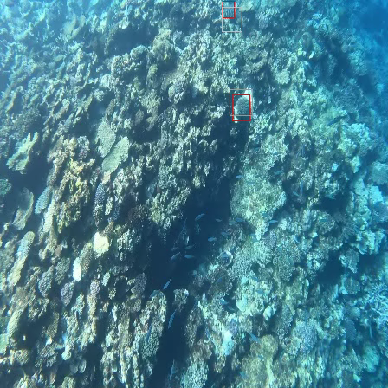
4 Results
Overfitting on Training Data
Ground Truth
Estimate
white: objectness = 1, black: objectness = 0

Slide 9
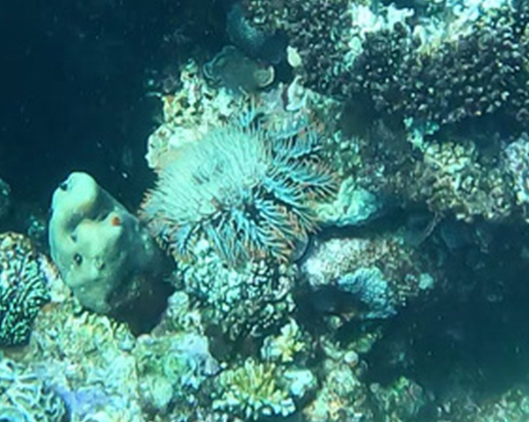
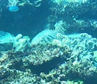
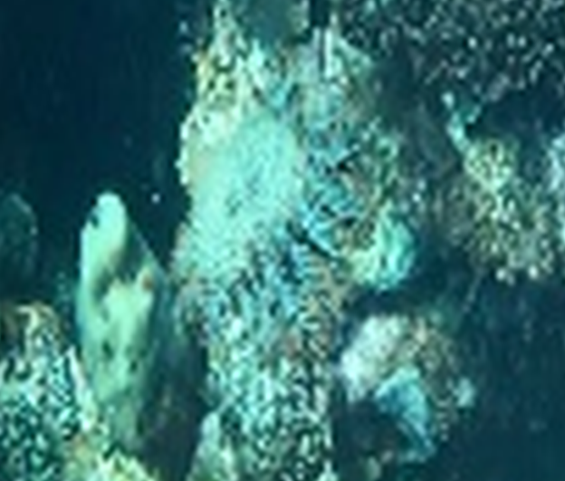
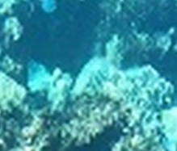
4 Results
Good example
Average example
Original resolution
Cropped from 1280x720 image
Original resolution
Cropped from 448x448 image

Slide 10
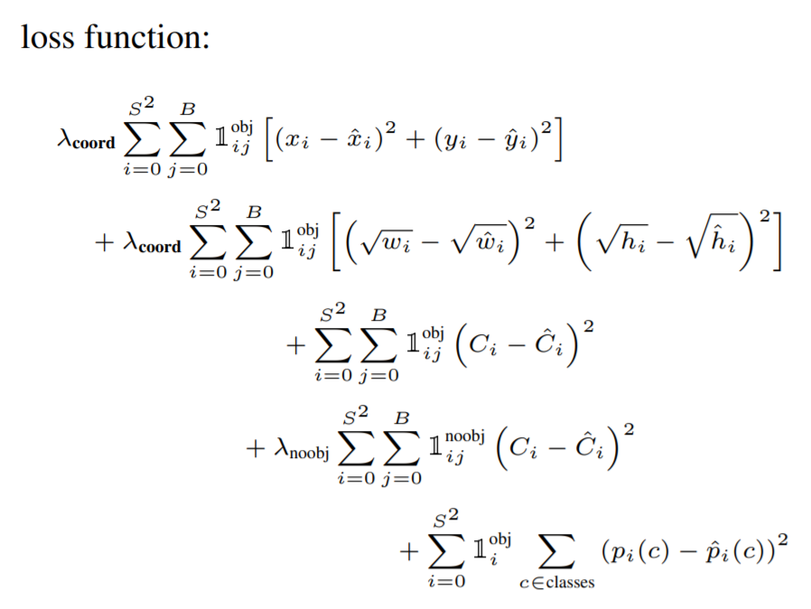
Backup – YOLO loss function

Slide 11
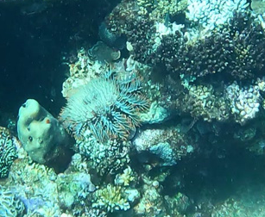
Backup

